Slide 1
OneTick Training
JOIN and MERGE EPs

Slide 2
JOIN EPs
OneTick tries to use terminology similar to relational DB terminology.
The main difference is that we are dealing with time series information
When people want to join several time series they usually want to join the “latest” data from each time series together

Slide 3
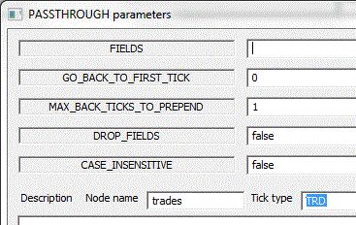
JOIN_BY_TIME
Takes multiple time series as input
Each source time series in the graph is named by setting the EP Node Name in GUI
An OUTER join will create a new tick with the latest tick from the leading source(s).
An INNER join will create a new tick with the latest tick from leading source(s) only when a tick can be found in other sources.
This is almost the same as in regular databases – but the fact that we are looking back in time from the leading source timestamp creates some differences in actual behavior.

Slide 4
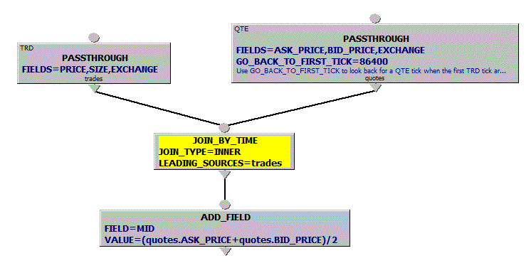
JOIN_BY_TIME (cont.)
Example:
Join
each trade
with the prevailing quote
A common usage is to look at the state of one data source (often a stream of quotes) each time an event is seen on another stream ( often a stream of trades)
To do this we set the event stream as the leading source.
If the join is INNER we will not see output for any trade events that happen before the first quote event, as these trades will not find a quote to join with.
If the join is OUTER we may see trades with no attached quote info.
Best solution may be to use OUTER but to have GO_BACK_TO_FIRST_TICK in the quote PASSTHROUGH.

Slide 5
JOIN_BY_TIME (cont.)
MATCH_IF_IDENTICAL_TIME :
TRUE value causes an output tick to be formed from input ticks with identical timestamps only
If JOIN_TYPE is set to OUTER, empty values of fields are propagated for sources that did not tick at a given timestamp.
See help details for the parameter SAME_TIMESTAMP_JOIN_POLICY to tune the join

Slide 6
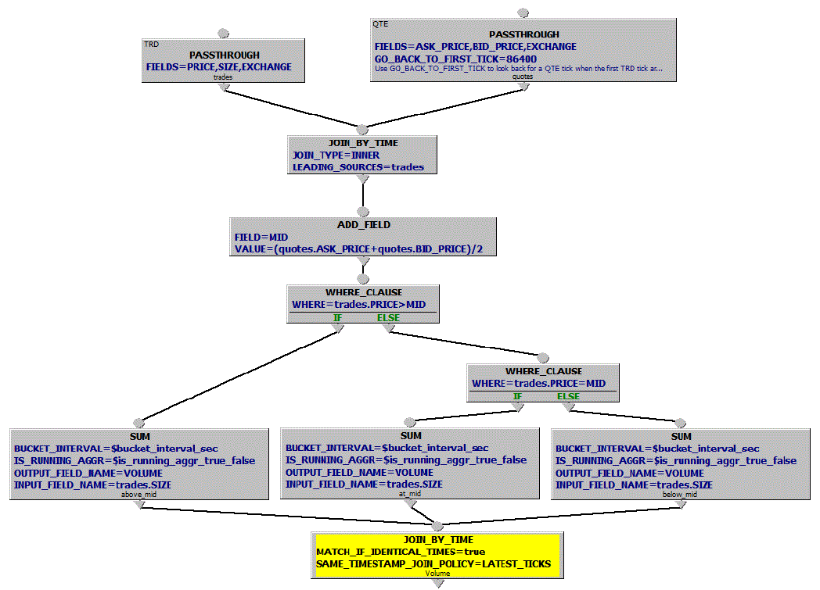
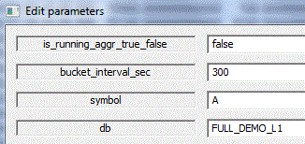
Example 1: Calculate volume of trades above, below and at MID for each 5 minute interval

Slide 7
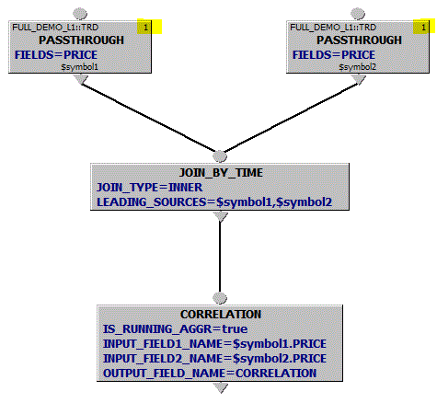
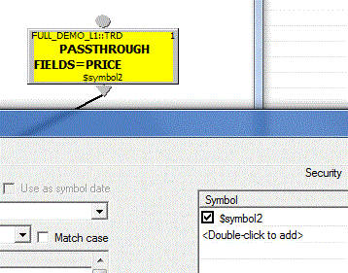
Example 2: Correlation between 2 security prices
Note “1” in top right corners: it means 1 Security Binding* Right-click on PASSTHROUGH, select Bind Security List (or Ctrl-I)
* See Help / EP Guide on Bound and Unbound Symbols for more…

Slide 8
Example 2: Correlation between 2 security prices (cont.)
JOIN_TYPE=INNER will make sure all ticks carry the latest PRICE for $symbol1 and $symbol2
Note usage of $symbol[n] query parameters in Security Bindings, node names and input field names
* We’ll be covering Bound and Unbound Symbols MUCH more later…

Slide 9
JOIN_BY_TIME with keys
A JOIN_BY_TIME can specify that we only achieve a match if we also match other fields on the tick streams. For this we use the JOIN_KEYS parameter.
This does have limitations. We can only specify field names, which are expected to be present in all input streams.
The example shows a TRD/QTE join where we want to join each TRD with the last QTE for the same exchange as we see on the TRD.

Slide 10
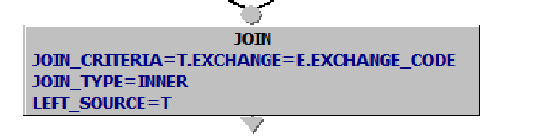
JOIN
A JOIN can specify a WHERE clause similar to what you have in a regular RDMS
Examples:
Join a single tick from one time series with a group of ticks from another time series. E.g., join an order to all of its executions. Or, to join an order to all of the trades executed while the order was being filled.
Join 2 time series for a pair of symbols to produce cross-symbol calculations (though there are other ways)

Slide 11
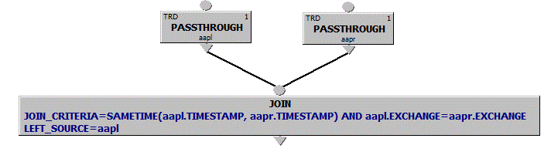
JOIN (cont.)
Note JOIN limitation vs JOIN_BY_TIME:
JOIN takes 2 sources only!
JOIN_BY_TIME takes any number.
The WHERE clause can use special functions SAMETIME or SAMETIME_AS_EXISTING or direct comparison of TIMESTAMP fields to match records from the two sources. Tips: SAMETIME.. functions take precedence over all other conditions so some times direct comparisons are preferred. However, avoiding SAMETIME.. functions can lead to slower queries.
SAMETIME.. Functions make JOIN useful in CEP queries as we are only looking backwards (more later).
Also, be aware of Cartesian JOINs that can cause tick server memory issues
All JOIN EPs rename all input fields with <source node name>.<original field name>

Slide 12
JOIN_SAME_SIZE_TS
If you KNOW that 2 (or more) tick series will ALWAYS have the same number of ticks, and you want to join the first tick in each series together, the second ticks together….the Nth ticks together then you can use JOIN_SAME_SIZE_TS to do this.
Frequent use cases are where you know 2 branches only output a single tick or where the input branches are bucketed aggregations using the same bucketing interval.
LEADING_SOURCE defines which series provides the timestamp. Not usually needed.
Can be used to create matrices.

Slide 13
JOIN_WITH_QUERY Later…..

Slide 14
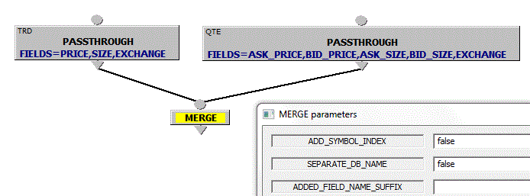
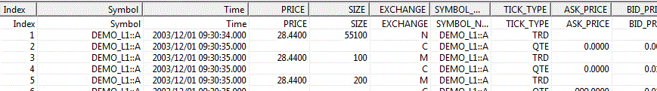
MERGE
MERGE multiple time series into one according to the original order (based on TIMESTAMP + OMDSEQ if available)
Example 1: Replay the market - MERGE Trades and Quotes into 1 time series as they were received
Next - merge multiple symbol time series into 1 to produce cross-symbol calculations. Details are in “Bound and Unbound Symbols” in GUI EP Help

Slide 15
MERGEing data from different symbols TOMORROW

Slide 16
GUI Exercise 1
Write a query to join trades and quotes
Add quote mid point
Calculate trade price vs mid spread
For each trade, compare the price to the MID. Add flag fields marking the trades as above and below the MID
Save the query as c:\omd\client_data\otqs\sample1.otq

Slide 17
GUI Exercise 2
For a given symbol (MSFT)
For a given period (20180205-20180209)
For exchange hours 9:30-16:00 EST
For each 30 minute time period
Show the volume of each 30 minute bucket as a percentage of the total volume over the day.
Chart the output.
[Hints: Join bucketed and un-bucketed data by time. Use ADD_FIELD to add percentage – we haven’t looked at this much yet. Remember “Apply Times Daily”. Look at Tools/Options to set an appropriate chart format of “Horizontal and vertical lines”]
You should end up with this….

Slide 18
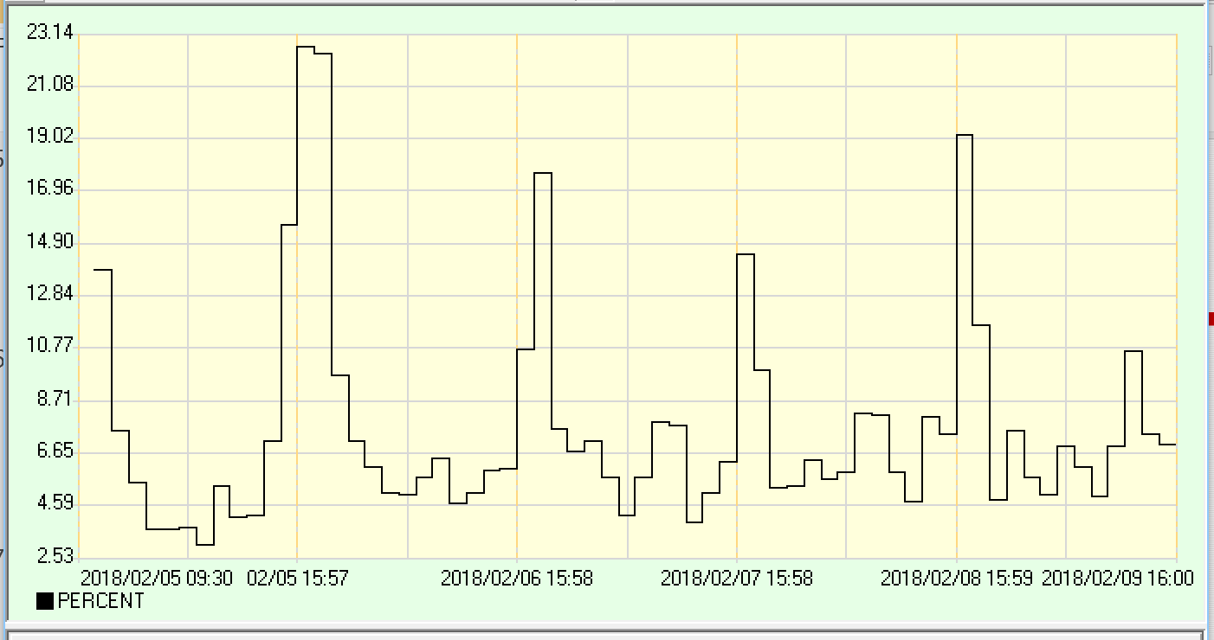
GUI Exercise 2

